Slide 1



Global-K
Co-living house RAONNURI
Share house HOMEKIM

Slide 2








ABOUT Global-K Group specializing in accommodation for international students
We provide clean and safe accommodation at a reasonable price.
We promptly address complaints from international students.
We help international students settle into Korean life.
Variety of accommodation options at reasonable prices
Wireless Internet provided
Clean residential environment and comfortable interior
Kitchen (i.e. microwave, stove-top)
Fully functional home appliances (washing machine, refrigerator, clothes dryer, etc.)
Provides firefighting facilities
and fire insurance
Opportunities for cultural exchanges
Fully equipped with heating
and cooling facilities

Slide 3
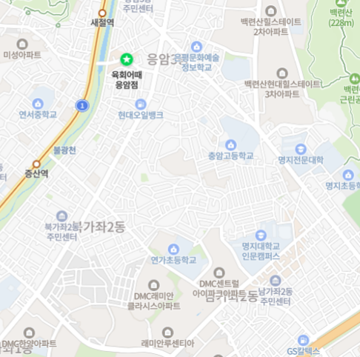
LOCATION
Home Kim 1st branch
Home Kim 2nd branch
Home Kim 3rd branch
Home Kim 4th branch
Home Kim 5th branch
F
A
B
C
D
D
E
C
F
RAONNURI
A
E
B

Slide 4
ABOUT Global-K : Compare options
division | Price range (10,000 won)) | Product features | Product Advantages | home page | Contact manager email
Home Kim 1st | 38~45 | 3 rooms, 2 people per room (bunk bed), special room (large room), maximum 6 people | reasonable price, Women only | HOME KIM Sharehouse For Exchange student (notion.site) | kpw2358@gmail.com wechat : homekims
Home Kim 2nd | 38~45 | 3 rooms, 2 people per room (bunk bed), special room (large room), maximum 6 people | reasonable price, Women only | HOME KIM Sharehouse For Exchange student (notion.site) | kpw2358@gmail.com wechat : homekims
Home Kim 3rd | 47~57 | 2 rooms, double room (twin bed) + single room, maximum 3 people | Large private space, women only | https://satisfying-buttercup-771.notion.site/Sharehouse-HOME-KIM-3-aa5bb766afbc45ec8bf7777397fd476e?pvs=4 | wanttoid@naver.com
Home Kim 4th | 47~57 | 2 rooms, double room (twin bed) + single room, maximum 3 people | Large private space, women only | https://satisfying-buttercup-771.notion.site/Sharehouse-HOME-KIM-4-13cb846269a3476fa4e479ea97dbcb51?pvs=4 | wanttoid@naver.com
Home Kim 5th | 39~45 | 2 rooms, 2 people per room (bunk bed), maximum 4 people | Large private space, men only
RAONNURI | 65 | One room per person (private bathroom in the room), apartment type | Good facilities and privacy possible | https://satisfying-buttercup-771.notion.site/RAONNURI-74e6329a38724a1cb728f5a9231edf07?pvs=74 | info@raon-nuri.kr or nh_2014@naver.com

